Slide 1

CSC 202 - Basics of Programming and Algorithms
Second Term - 1439/1440
Lecture #1
Dr. Hazem Ibrahim Shehata
Assistant Professor
College of Computing and Information Technology

Slide 2
Teaching Staff
Lectures (Sunday 8:00am – 10:00am):
Name: Hazem Ibrahim Shehata
Office: Room #2526, Colleges Building
Email: hshehata@su.edu.sa
Labs (????? ??:??pm – ??:??pm):
Name: Nayyar Khan
Office: Room #2511, Colleges Building
Email: nayyar@su.edu.sa

Slide 3
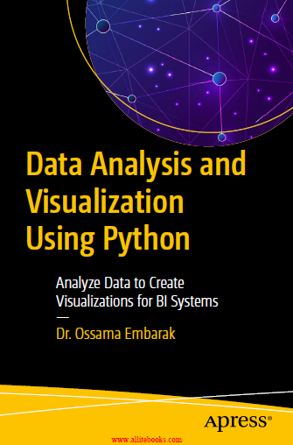
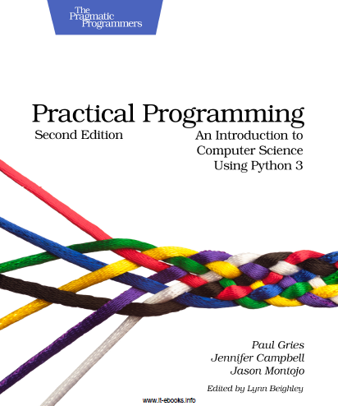
Course Info
Course website:
SULMS ➔ https://sulms.su.edu.sa/course/view.php?id=411
Self-enrolment is open for 1 week!
Textbooks:
O. Embarak, Data Analysis and Visualization Using Python, 1st ed., Apress, 2018.
P. Gries, J. Campbell and J. Montojo, Practical Programming: An Introduction to Computer Science Using Python 3, 2nd ed., The Pragmatic Programmers, 2013.

Slide 4
Course Info (Cont.)
Software Tools
Python 3.7
Python Interpreter and IDLE IDE.
Download: https://www.python.org/downloads/

Slide 5
Course Info (Cont.)
Grading
Course Work | Grade Distribution
Midterm Exam (1) | 20pt | 60pt
Midterm Exam (2) | 20pt
Lab Exam | 10pt
Quizzes, Assignments, Project, … etc. | 10pt
Final Exam | 40pt
Total Points | 100pt

Slide 6
Course Outline
Introduction to Programming and Algorithms
History, types, generations, algorithms, flow charts, pseudocode, … etc.
Python Fundamentals
Types, expressions, functions, modules, data structures (strings, lists, sets, dictionaries), conditionals, repetitions, … etc.

Slide 7

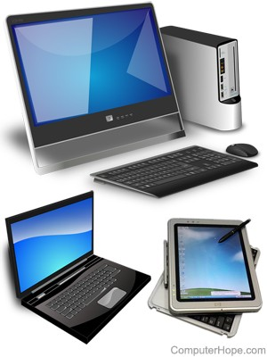
Computer Evolution
1950's
Large devices, accessible to few people
1960's
Commercial usage emerges
Operated by experts
1970’s
Computers cheaper, smaller
1990's
Computers fast, small, inexpensive
Owned and used by many people
This is because programming has become easier!

Slide 8
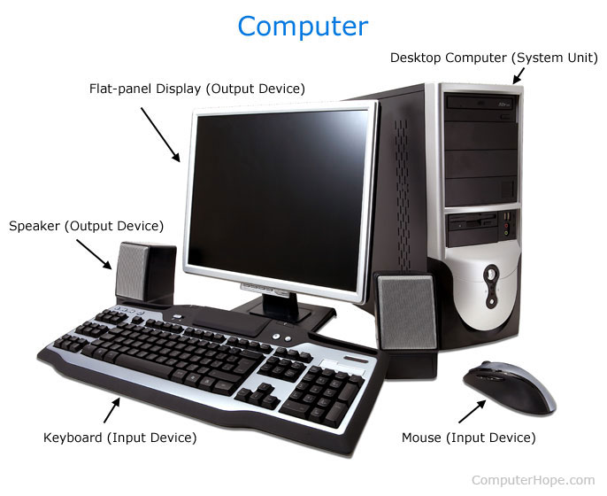
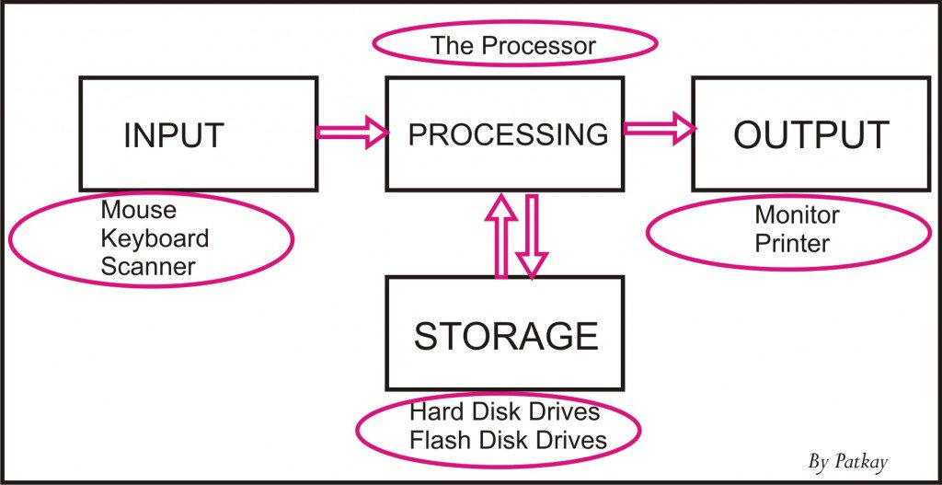
What is a computer?
Computer is an electronic device that manipulates information and/or data.
Information and/or data enters the computer as input, and then processed to produce output.

Slide 9
Hardware vs. Software
Any computer system has two major components: Hardware and software.
Hardware: collection of physical parts of a computer system that has a shape, size and can be felt.
Software: computer instructions (or programs) that tell the hardware what to do and how to do it.

Slide 10
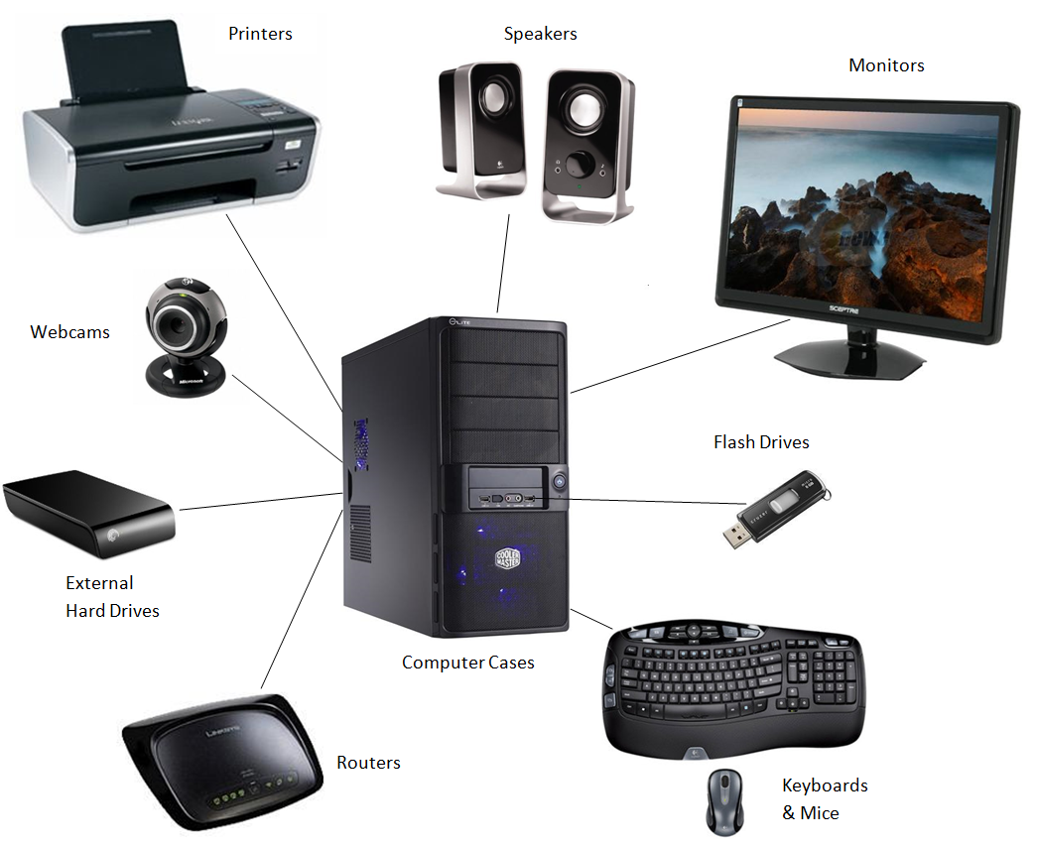
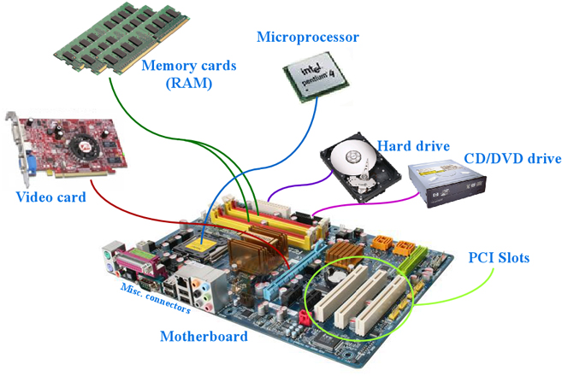
Computer Hardware (H/W)

Slide 11
Computer Software (S/W)
System S/W: programs written for computer systems
Ex.: Operating systems, drivers, compilers, … etc.
Operating systems provide several essential services:
Loading/running application programs, allocating memory & processor time, providing input & output facilities, managing files.
Application S/W: programs written for computer users
Ex.: Word-processors, spreadsheets, … etc.
Application programs are written to solve problems or perform tasks on a computer

Slide 12
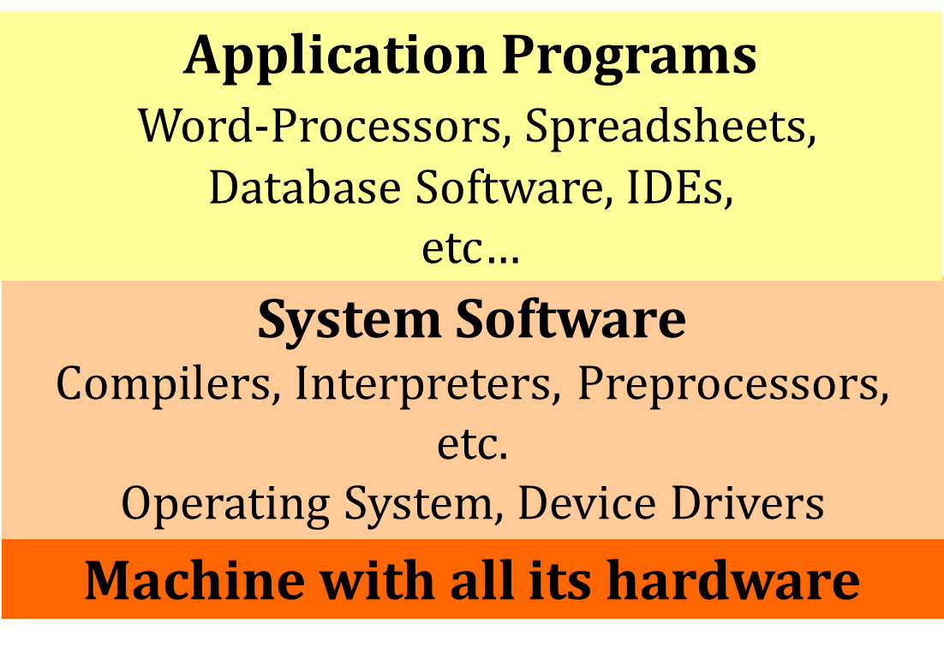
Layered view of the Computer

Slide 13
Programming Languages
Both system and application programs are written using programming languages.
A programming language is:
a special purpose language
with a set of rules and symbols used to construct a computer program to interact with computer.
There are hundreds of programming languages out there!!
https://en.wikipedia.org/wiki/List_of_programming_languages#A

Slide 14
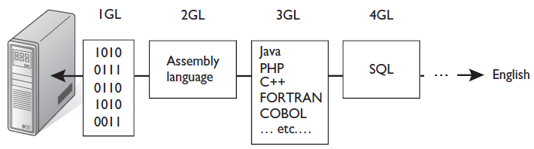
Programming Language Generations
Programming languages have evolved over time.
Commonly classified to five generations: 1GL, 2GL, …, 5GL.
Earlier generations are closer to machine languages!
Later generations are closer to natural human languages!

Slide 15
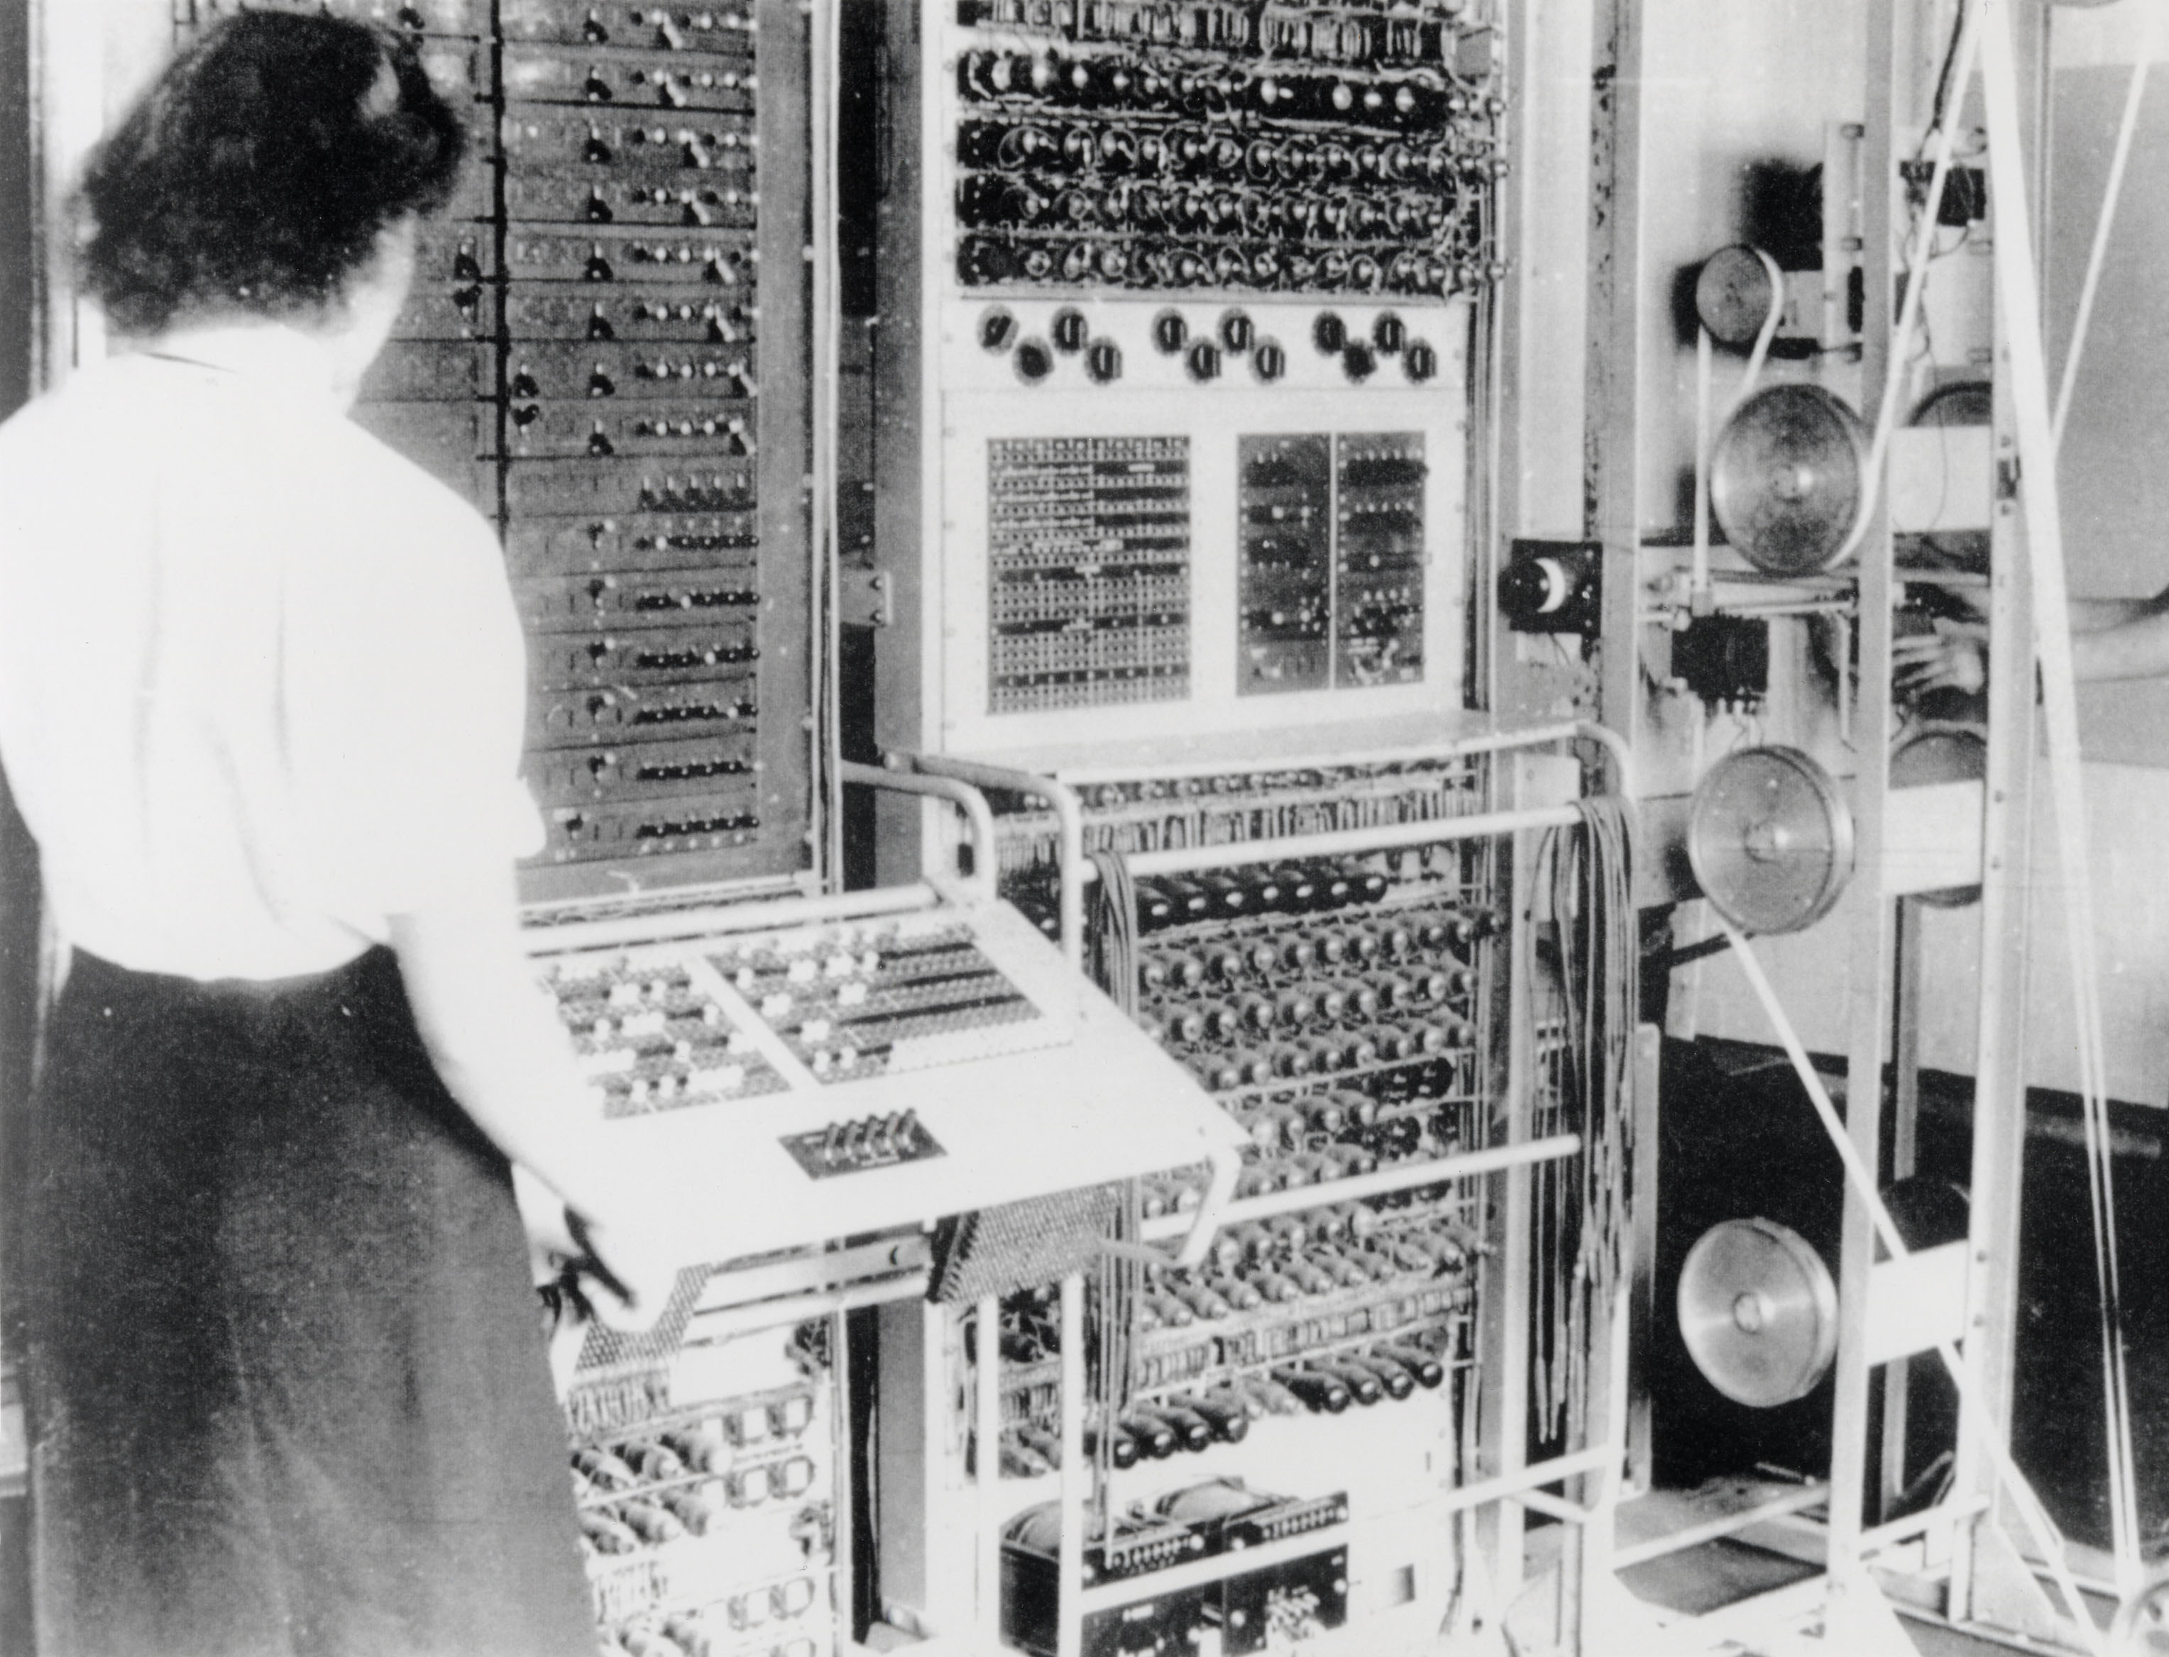

First Generation Languages (1GL)
“1GL” term refers the machine languages (ML).
Earliest computers were programmed using machine code.
Instructions are strings of 1’s and 0’s ➔ 1001101101010001
Programmers design their code by hand then transfer it to a computer by using a punch card or flicking switches.
No translation ➔ fast/efficient code!
Hard to understand ➔ hard to modify!
Hardware dependent ➔ unportable code!

Slide 16
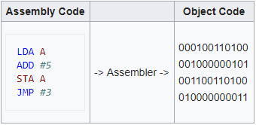
Second Generation Languages (2GL)
“2GL” term refers the assembly languages (AL).
Assembly instructions use symbolic names (mnemonics).
Ex.: ADD #5.
AL programs are translated to ML by assembler.
Simple translation ➔ fast/efficient code!
Easier to understand (compared to 1GL)!
Hardware dependent ➔ unportable code!

Slide 17
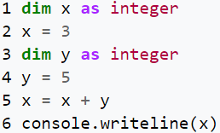
Third Generation Languages (3GL)
“3GL” term refers the high-level languages (HLL).
Support many programmer-friendly features
Ex.: variables, conditionals, loops, functions, … etc.
HLL prog.’s are translated to ML by compiler or interpreter.
Slower/bigger programs (compared to 2GL)
Easier to understand (compared to 2GL)!
Hardware independent ➔ portable code!
Examples:
C, C++ ,Java, Python, … etc.

Slide 18
Assembler vs. Compiler vs. Interpreter
Assembler | Compiler | Interpreter
Converts form AL to ML | Converts from HLL to ML
Converts whole program at once |  | Coverts program line by line
Used in assembly languages | Used in Java, C, C++, … etc. | Used in Python, Ruby, PHP, … etc.

Slide 19
Fourth Generation Languages (4GL)
Designed to be closer to natural languages than a 3GL.
Ex.: SELECT Name, DoB FROM StudentsTable WHERE Grades>60;
Contains built-in support for: database management, report generation, mathematical optimization, GUI development, or web development.
Examples: SQL, Oracle Reports, Matlab, … etc.

Slide 20
Fifth Generation Languages (5GL)
Designed to make computer solve a given problem without the programmer!
Programmer defines problem constraints rather than algorithm.
Used mainly in artificial intelligence research.
Examples: OPS5 and Mercury.

Slide 21
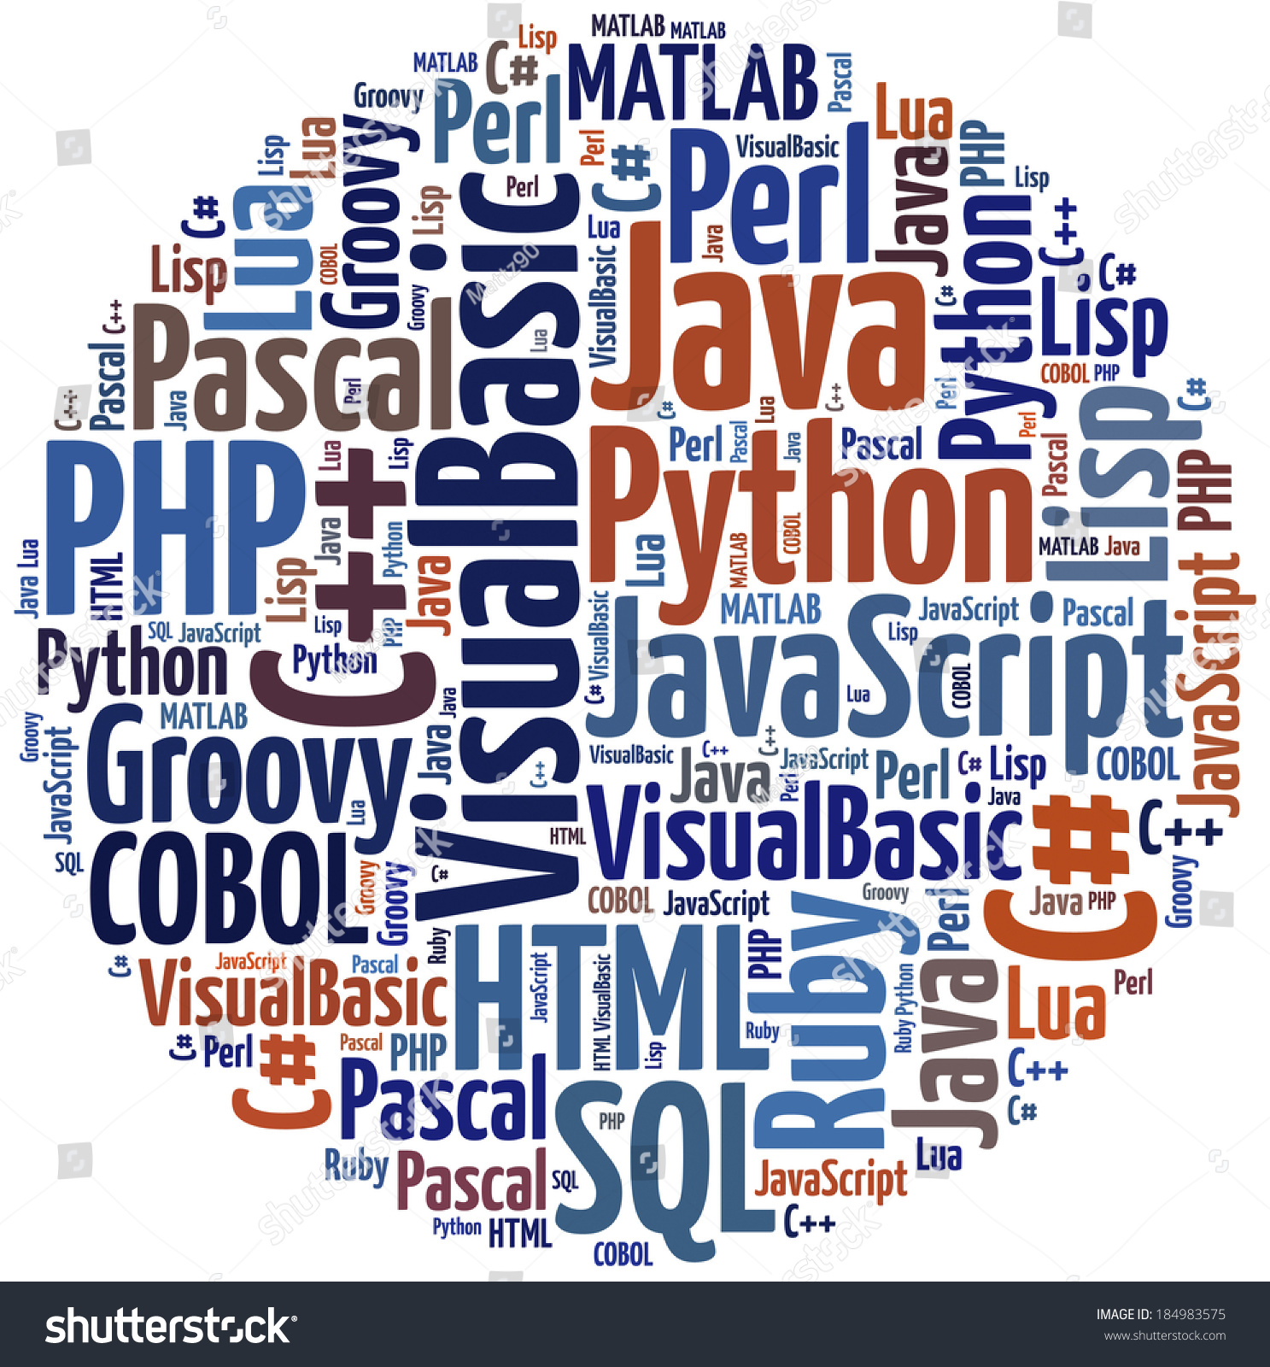
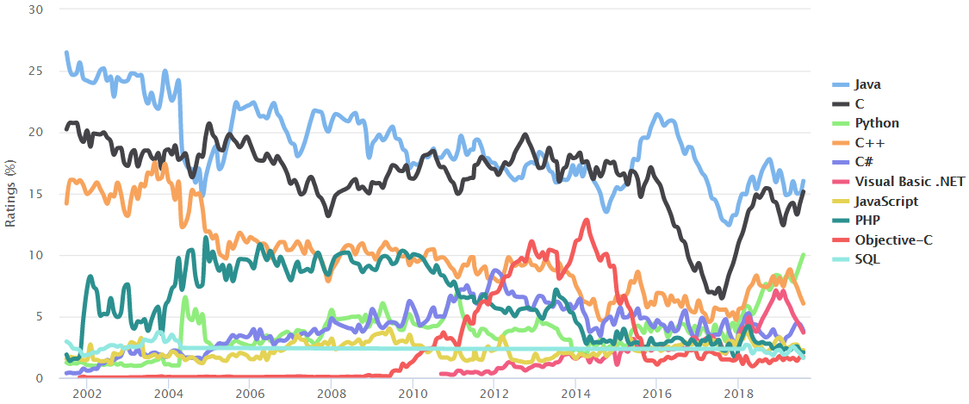
Which Language to learn?!

Slide 22
